Slide 1
Neural Networks for Machine Learning Lecture 1a Why do we need machine learning?
Geoffrey Hinton
with
Nitish Srivastava
Kevin Swersky

Slide 2
What is Machine Learning?
It is very hard to write programs that solve problems like recognizing a three-dimensional object from a novel viewpoint in new lighting conditions in a cluttered scene.
We don’t know what program to write because we don’t know how its done in our brain.
Even if we had a good idea about how to do it, the program might be horrendously complicated.
It is hard to write a program to compute the probability that a credit card transaction is fraudulent.
There may not be any rules that are both simple and reliable. We need to combine a very large number of weak rules.
Fraud is a moving target. The program needs to keep changing.

Slide 3
The Machine Learning Approach
Instead of writing a program by hand for each specific task, we collect lots of examples that specify the correct output for a given input.
A machine learning algorithm then takes these examples and produces a program that does the job.
The program produced by the learning algorithm may look very different from a typical hand-written program. It may contain millions of numbers.
If we do it right, the program works for new cases as well as the ones we trained it on.
If the data changes the program can change too by training on the new data.
Massive amounts of computation are now cheaper than paying someone to write a task-specific program.

Slide 4
Some examples of tasks best solved by learning
Recognizing patterns:
Objects in real scenes
Facial identities or facial expressions
Spoken words
Recognizing anomalies:
Unusual sequences of credit card transactions
Unusual patterns of sensor readings in a nuclear power plant
Prediction:
Future stock prices or currency exchange rates
Which movies will a person like?

Slide 5
A standard example of machine learning
A lot of genetics is done on fruit flies.
They are convenient because they breed fast.
We already know a lot about them.
The MNIST database of hand-written digits is the the machine learning equivalent of fruit flies.
They are publicly available and we can learn them quite fast in a moderate-sized neural net.
We know a huge amount about how well various machine learning methods do on MNIST.
We will use MNIST as our standard task.

Slide 6
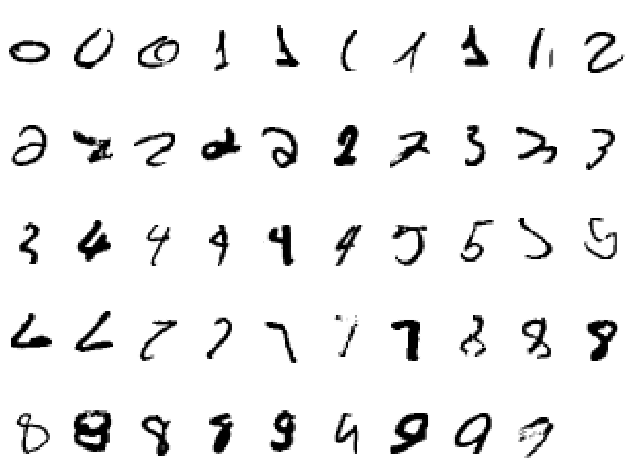
It is very hard to say what makes a 2

Slide 7
Beyond MNIST: The ImageNet task
1000 different object classes in 1.3 million high-resolution training images from the web.
Best system in 2010 competition got 47% error for its first choice and 25% error for its top 5 choices.
Jitendra Malik (an eminent neural net sceptic) said that this competition is a good test of whether deep neural networks work well for object recognition.
A very deep neural net (Krizhevsky et. al. 2012) gets less that 40% error for its first choice and less than 20% for its top 5 choices (see lecture 5).

Slide 8
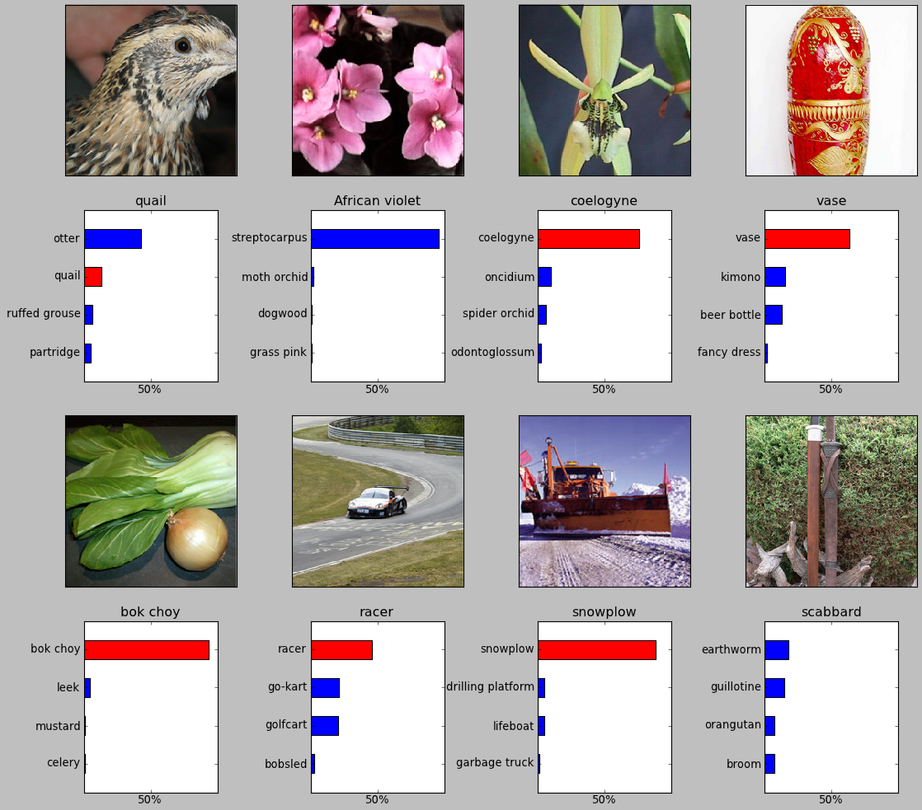
Some examples from an earlier version of the net

Slide 9
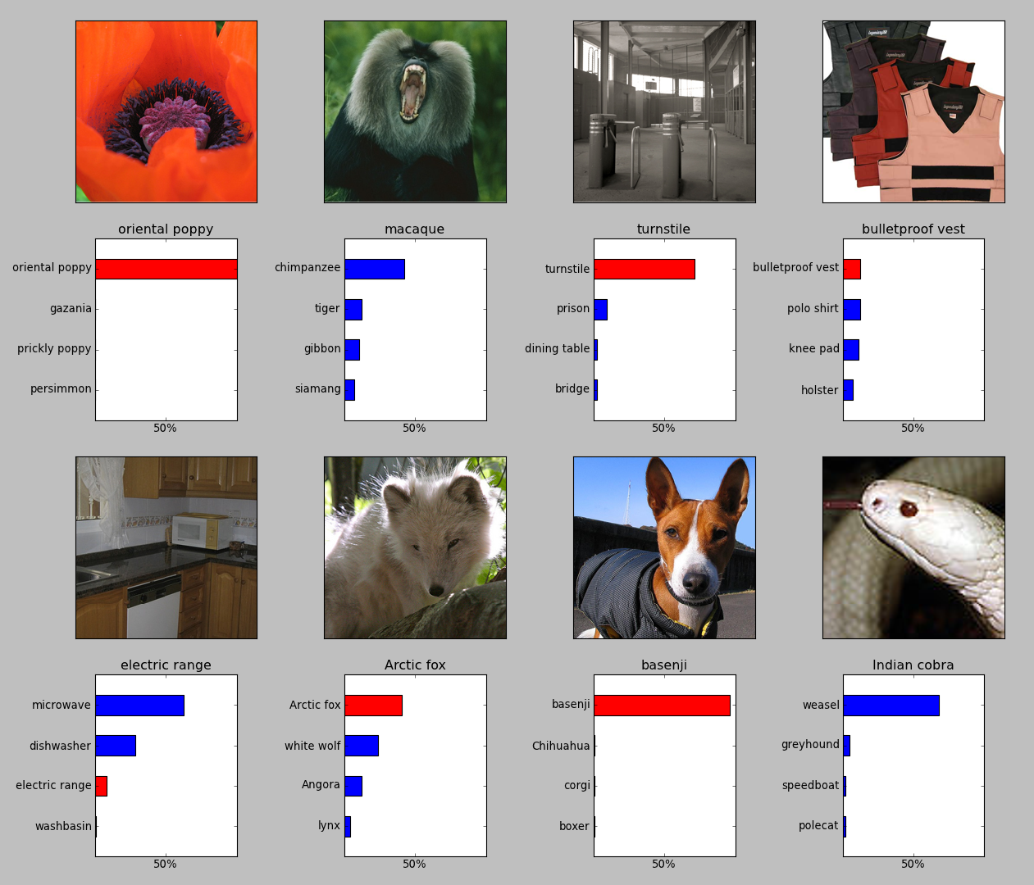
It can deal with a wide range of objects

Slide 10
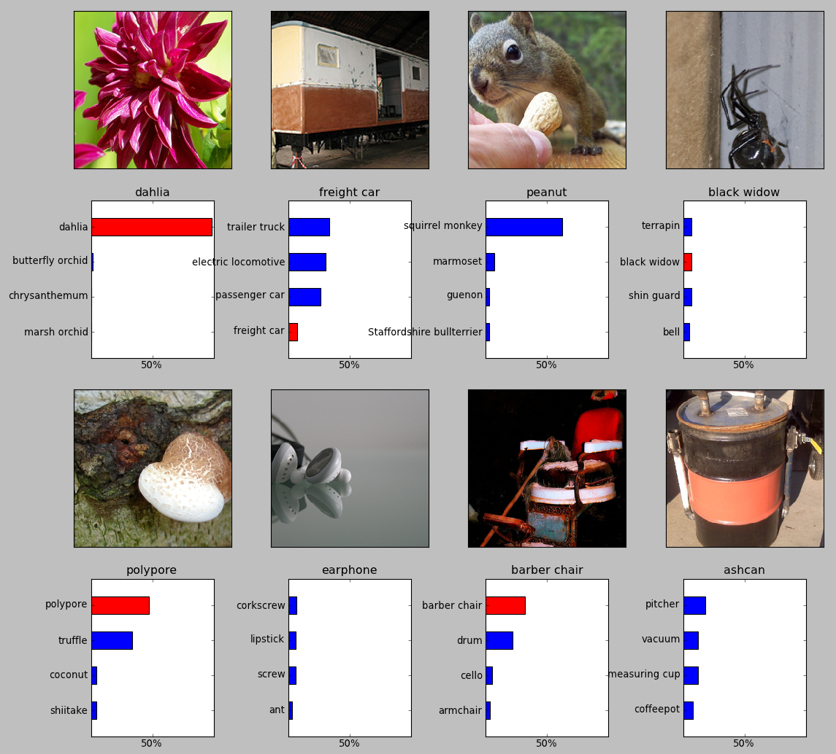
It makes some really cool errors

Slide 11
The Speech Recognition Task
A speech recognition system has several stages:
Pre-processing: Convert the sound wave into a vector of acoustic coefficients. Extract a new vector about every 10 mille seconds.
The acoustic model: Use a few adjacent vectors of acoustic coefficients to place bets on which part of which phoneme is being spoken.
Decoding: Find the sequence of bets that does the best job of fitting the acoustic data and also fitting a model of the kinds of things people say.
Deep neural networks pioneered by George Dahl and Abdel-rahman Mohamed are now replacing the previous machine learning method for the acoustic model.

Slide 12
Phone recognition on the TIMIT benchmark (Mohamed, Dahl, & Hinton, 2012)
After standard post-processing using a bi-phone model, a deep net with 8 layers gets 20.7% error rate.
The best previous speaker- independent result on TIMIT was 24.4% and this required averaging several models.
Li Deng (at MSR) realised that this result could change the way speech recognition was done.
183 HMM-state labels
not pre-trained
2000 logistic hidden units
5 more layers of pre-trained weights
2000 logistic hidden units
2000 logistic hidden units
15 frames of 40 filterbank outputs
+ their temporal derivatives

Slide 13
Word error rates from MSR, IBM, & Google (Hinton et. al. IEEE Signal Processing Magazine, Nov 2012)
The task | Hours of training data | Deep neural network | Gaussian Mixture Model | GMM with more data
Switchboard (Microsoft Research) | 309 | 18.5% | 27.4% | 18.6% (2000 hrs)
English broadcast news (IBM) | 50 | 17.5% | 18.8%
Google voice search (android 4.1) | 5,870 | 12.3% (and falling) |  | 16.0% (>>5,870 hrs)

Slide 14
Neural Networks for Machine Learning Lecture 1b What are neural networks?
Geoffrey Hinton
with
Nitish Srivastava
Kevin Swersky

Slide 15
Reasons to study neural computation
To understand how the brain actually works.
Its very big and very complicated and made of stuff that dies when you poke it around. So we need to use computer simulations.
To understand a style of parallel computation inspired by neurons and their adaptive connections.
Very different style from sequential computation.
should be good for things that brains are good at (e.g. vision)
Should be bad for things that brains are bad at (e.g. 23 x 71)
To solve practical problems by using novel learning algorithms inspired by the brain (this course)
Learning algorithms can be very useful even if they are not how the brain actually works.

Slide 16
A typical cortical neuron
Gross physical structure:
There is one axon that branches
There is a dendritic tree that collects input from other neurons.
Axons typically contact dendritic trees at synapses
A spike of activity in the axon causes charge to be injected into the post-synaptic neuron.
Spike generation:
There is an axon hillock that generates outgoing spikes whenever enough charge has flowed in at synapses to depolarize the cell membrane.
axon
axon hillock
body
dendritic
tree

Slide 17
Synapses
When a spike of activity travels along an axon and arrives at a synapse it causes vesicles of transmitter chemical to be released.
There are several kinds of transmitter.
The transmitter molecules diffuse across the synaptic cleft and bind to receptor molecules in the membrane of the post-synaptic neuron thus changing their shape.
This opens up holes that allow specific ions in or out.

Slide 18
How synapses adapt
The effectiveness of the synapse can be changed:
vary the number of vesicles of transmitter.
vary the number of receptor molecules.
Synapses are slow, but they have advantages over RAM
They are very small and very low-power.
They adapt using locally available signals
But what rules do they use to decide how to change?

Slide 19
How the brain works on one slide!
Each neuron receives inputs from other neurons
A few neurons also connect to receptors.
Cortical neurons use spikes to communicate.
The effect of each input line on the neuron is controlled
by a synaptic weight
The weights can be positive or negative.
The synaptic weights adapt so that the whole network learns to perform useful computations
Recognizing objects, understanding language, making plans, controlling the body.
You have about neurons each with about weights.
A huge number of weights can affect the computation in a very short time. Much better bandwidth than a workstation.

Slide 20
Modularity and the brain
Different bits of the cortex do different things.
Local damage to the brain has specific effects.
Specific tasks increase the blood flow to specific regions.
But cortex looks pretty much the same all over.
Early brain damage makes functions relocate.
Cortex is made of general purpose stuff that has the ability to turn into special purpose hardware in response to experience.
This gives rapid parallel computation plus flexibility.
Conventional computers get flexibility by having stored sequential programs, but this requires very fast central processors to perform long sequential computations.

Slide 21
Neural Networks for Machine Learning Lecture 1c Some simple models of neurons
Geoffrey Hinton
with
Nitish Srivastava
Kevin Swersky

Slide 22
Idealized neurons
To model things we have to idealize them (e.g. atoms)
Idealization removes complicated details that are not essential for understanding the main principles.
It allows us to apply mathematics and to make analogies to other, familiar systems.
Once we understand the basic principles, its easy to add complexity to make the model more faithful.
It is often worth understanding models that are known to be wrong (but we must not forget that they are wrong!)
E.g. neurons that communicate real values rather than discrete spikes of activity.

Slide 23
Linear neurons
These are simple but computationally limited
If we can make them learn we may get insight into more complicated neurons.
bias
th
i input
weight on
output
th
i
input
index over
input connections

Slide 24
Linear neurons
These are simple but computationally limited
If we can make them learn we may get insight into more complicated neurons.
y
0
0

Slide 25
Binary threshold neurons
McCulloch-Pitts (1943): influenced Von Neumann.
First compute a weighted sum of the inputs.
Then send out a fixed size spike of activity if the weighted sum exceeds a threshold.
McCulloch and Pitts thought that each spike is like the truth value of a proposition and each neuron combines truth values to compute the truth value of another proposition!
1
output
0
threshold
weighted input

Slide 26
Binary threshold neurons
There are two equivalent ways to write the equations for a binary threshold neuron:
1 if
1 if
0 otherwise
0 otherwise

Slide 27
Rectified Linear Neurons (sometimes called linear threshold neurons)
They compute a linear weighted sum of their inputs.
The output is a non-linear function of the total input.
y
z
0 otherwise
0

Slide 28
Sigmoid neurons
These give a real-valued output that is a smooth and bounded function of their total input.
Typically they use the logistic function
They have nice derivatives which make learning easy (see lecture 3).
1
0.5
0
0

Slide 29
Stochastic binary neurons
These use the same equations as logistic units.
But they treat the output of the logistic as the probability of producing a spike in a short time window.
We can do a similar trick for rectified linear units:
The output is treated as the Poisson rate for spikes.
1
0.5
0
0

Slide 30
Neural Networks for Machine Learning Lecture 1d A simple example of learning
Geoffrey Hinton
with
Nitish Srivastava
Kevin Swersky

Slide 31
A very simple way to recognize handwritten shapes
Consider a neural network with two layers of neurons.
neurons in the top layer represent known shapes.
neurons in the bottom layer represent pixel intensities.
A pixel gets to vote if it has ink on it.
Each inked pixel can vote for several different shapes.
The shape that gets the most votes wins.
0 1 2 3 4 5 6 7 8 9

Slide 32
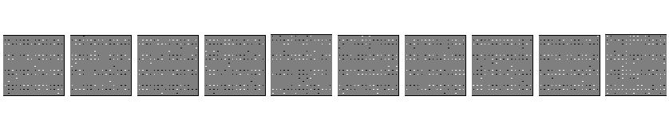
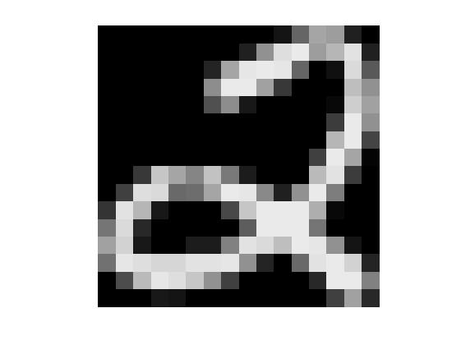
How to display the weights
1 2 3 4 5 6 7 8 9 0
The input image
Give each output unit its own “map” of the input image and display the weight coming from each pixel in the location of that pixel in the map.
Use a black or white blob with the area representing the magnitude of the weight and the color representing the sign.

Slide 33
How to learn the weights
1 2 3 4 5 6 7 8 9 0
The image
Show the network an image and increment the weights from active pixels to the correct class.
Then decrement the weights from active pixels to whatever class the network guesses.

Slide 34
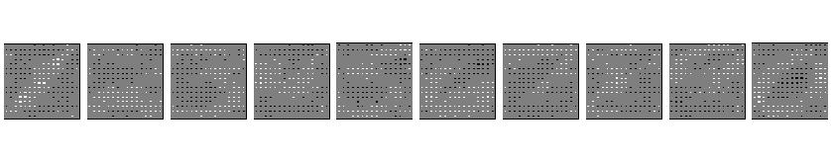
1 2 3 4 5 6 7 8 9 0
The image

Slide 35
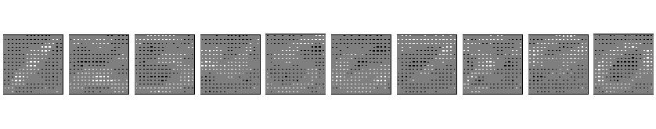
1 2 3 4 5 6 7 8 9 0
The image

Slide 36
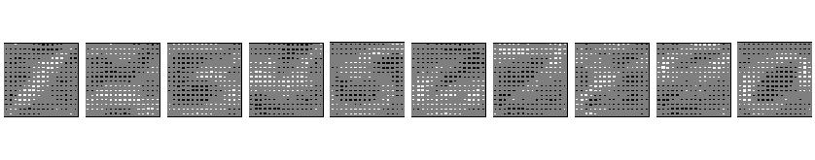
1 2 3 4 5 6 7 8 9 0
The image

Slide 37
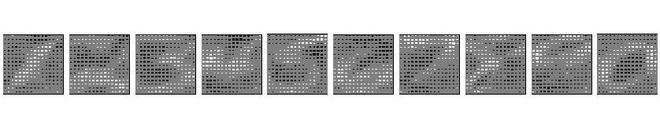
1 2 3 4 5 6 7 8 9 0
The image

Slide 38
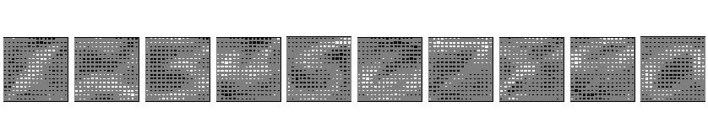
1 2 3 4 5 6 7 8 9 0
The image

Slide 39
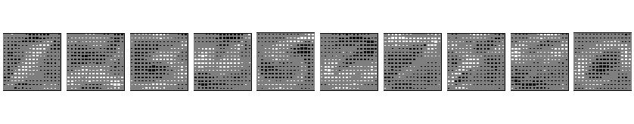
The learned weights
1 2 3 4 5 6 7 8 9 0
The image
The details of the learning algorithm will be explained in future lectures.

Slide 40
Why the simple learning algorithm is insufficient
A two layer network with a single winner in the top layer is equivalent to having a rigid template for each shape.
The winner is the template that has the biggest overlap with the ink.
The ways in which hand-written digits vary are much too complicated to be captured by simple template matches of whole shapes.
To capture all the allowable variations of a digit we need to learn the features that it is composed of.

Slide 41
Examples of handwritten digits that can be recognized correctly the first time they are seen

Slide 42
Neural Networks for Machine Learning Lecture 1e Three types of learning
Geoffrey Hinton
with
Nitish Srivastava
Kevin Swersky

Slide 43
Types of learning task
Supervised learning
Learn to predict an output when given an input vector.
Reinforcement learning
Learn to select an action to maximize payoff.
Unsupervised learning
Discover a good internal representation of the input.

Slide 44
Two types of supervised learning
Each training case consists of an input vector x and a target output t.
Regression: The target output is a real number or a whole vector of real numbers.
The price of a stock in 6 months time.
The temperature at noon tomorrow.
Classification: The target output is a class label.
The simplest case is a choice between 1 and 0.
We can also have multiple alternative labels.

Slide 45
How supervised learning typically works
We start by choosing a model-class:
A model-class, f, is a way of using some numerical parameters, W, to map each input vector, x, into a predicted output y.
Learning usually means adjusting the parameters to reduce the discrepancy between the target output, t, on each training case and the actual output, y, produced by the model.
For regression, is often a sensible measure of the discrepancy.
For classification there are other measures that are generally more sensible (they also work better).

Slide 46
Reinforcement learning
In reinforcement learning, the output is an action or sequence of actions and the only supervisory signal is an occasional scalar reward.
The goal in selecting each action is to maximize the expected sum of the future rewards.
We usually use a discount factor for delayed rewards so that we don’t have to look too far into the future.
Reinforcement learning is difficult:
The rewards are typically delayed so its hard to know where we went wrong (or right).
A scalar reward does not supply much information.
This course cannot cover everything and reinforcement learning is one of the important topics we will not cover.

Slide 47
Unsupervised learning
For about 40 years, unsupervised learning was largely ignored by the machine learning community
Some widely used definitions of machine learning actually excluded it.
Many researchers thought that clustering was the only form of unsupervised learning.
It is hard to say what the aim of unsupervised learning is.
One major aim is to create an internal representation of the input that is useful for subsequent supervised or reinforcement learning.
You can compute the distance to a surface by using the disparity between two images. But you don’t want to learn to compute disparities by stubbing your toe thousands of times.

Slide 48
Other goals for unsupervised learning
It provides a compact, low-dimensional representation of the input.
High-dimensional inputs typically live on or near a low-dimensional manifold (or several such manifolds).
Principal Component Analysis is a widely used linear method for finding a low-dimensional representation.
It provides an economical high-dimensional representation of the input in terms of learned features.
Binary features are economical.
So are real-valued features that are nearly all zero.
It finds sensible clusters in the input.
This is an example of a very sparse code in which only one of the features is non-zero.

